Slide 1
RETURN TO OFFICE PREDICTIONS
ERIN TANSLEY
REGIS UNIVERSITY
MSDS 692 SUMMER, 2021

Slide 2
PROJECT OVERVIEW
BACKGROUND
DATA OVERVIEW
DATA PROCESSING
LOGISTIC REGRESSION MODELS
FINDINGS
NEXT STEPS

Slide 3
BACKGROUND
The 2020-2021 global pandemic caused businesses to shift how the workplace existed almost overnight
Many businesses and employees were forced into considering remote working as both a temporary and permanent way of existing
This dataset was created and gathered for this project and may be used publicly

Slide 4
DATA REVIEW
This dataset is very small – 123 total records
20 different categories of data
FIELD | DESCRIPTION
Timestamp | The date and time the answer was submitted through the survey platform
UserID | Unique ID of the individual answering
ZipCode | Location of respondent
HouseholdSize | How many individuals live in respondent's residence
ResidenceType | What type of home the residence is classified as
ResidenceSize | How many bedrooms the residence has
HomeToOfficeDistance | How many miles the respondent lives to their work location
PublicTransit | Does the respondent take public transit
VehicleYear | The year the respondent's vehicle was made
VehicleReliable | Answer to if the respondent feels their vehicle is reliable
StatePoliticalClimate | The political climate of the respondent's state
OfficeClean | Answer to if the respondent feels that their office is clean
HomeClean | Answer to if the respondent feels that their home is clean
MentalHealthTX | Does the respondent receive mental health treatment
PhysicalHealthTX | Does the respondent receive physical health treatment
LifeGoalCategory | The category that the respondent feels their biggest life goal falls into
LifeGoalAttainable | Answer to if the respondent feels that their life goal is attainable
HobbyCategory | The category that the respondent feels their biggest hobby falls into
MissOfficeSocial | Answer to if the respondent misses the office social environment
ReturnToOffice | Predictor - Answer to if the respondent wants to return to the office in some capacity after the pandemic ends

Slide 5
DATA SAMPLE
How many people live in your household? | Type of Residence: | Size of Residence | Distance from Home to Office | Do you take any form of public transit (bus, light rail, train)? | Year personal vehicle was manufactured? | Do you feel your vehicle is reliable? | Political climate of your state? | Do you feel that your office setting is clean, safe and comfortable? | Do you feel that your home setting is clean, safe and comfortable?
2 | Apartment | 1 BR | 11 - 20 Miles | Yes | 2012 | No | Mixed | Yes | No
1 | Apartment | Studio | 31+ Miles | No | Dont have one | No | Mixed | No | Yes
1 | Apartment | 1 BR | 0 - 10 Miles | No | I do not own a personal vehicle | Yes | Liberal | No | Yes
44260 | Apartment | 4 BR+ | 0 - 10 Miles | Yes | 2021 | Yes | Liberal | No | Yes
44260 | House | 4 BR+ | 11 - 20 Miles | Yes | 2013 | Yes | Mixed | Yes | Yes
2 | House | 3 BR | 0 - 10 Miles | No | Don't know | Yes | Mixed | Yes | Yes
2 | Apartment | 2 BR | 0 - 10 Miles | No | 2015 | Yes | Mixed | Yes | Yes
44260 | Townhome | 3 BR | 0 - 10 Miles | No | 2006 | Yes | Liberal | Yes | Yes
2 | Apartment | 1 BR | 0 - 10 Miles | No | 2016 | Yes | Liberal | Yes | Yes
44260 | Apartment | 4 BR+ | 0 - 10 Miles | No | n/a | Yes | Mixed | Yes | Yes

Slide 6
DATA CLEANSING AND PREPARATION

Slide 7
VISUALIZING MISSING VALUES
MISSING VALUES

Slide 8
DATA TYPES
SUMMARY
STR

Slide 9
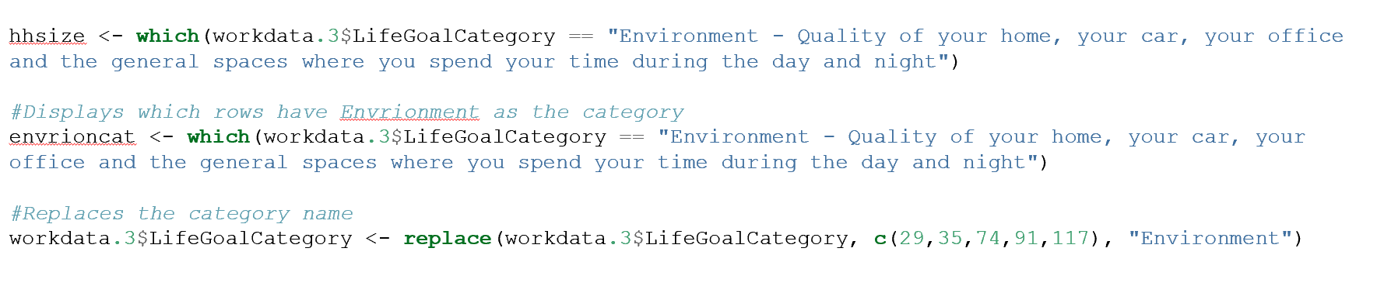
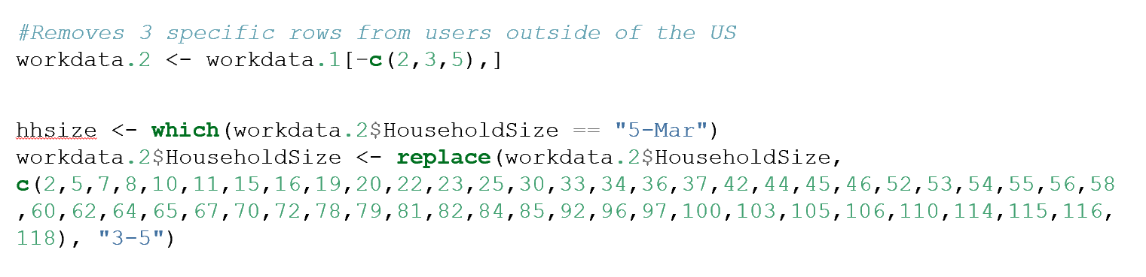
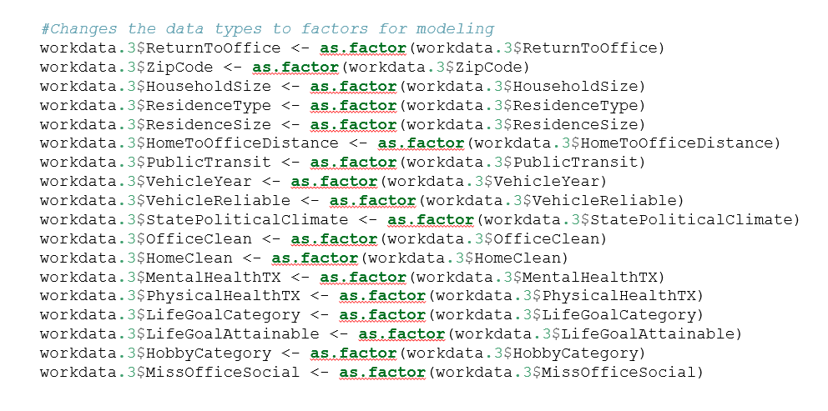
PRE-PROCESSING
NAMES
TEXT
TYPE

Slide 10
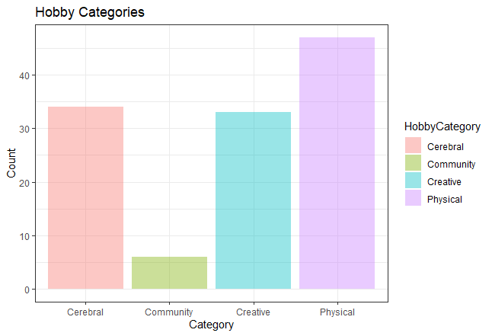
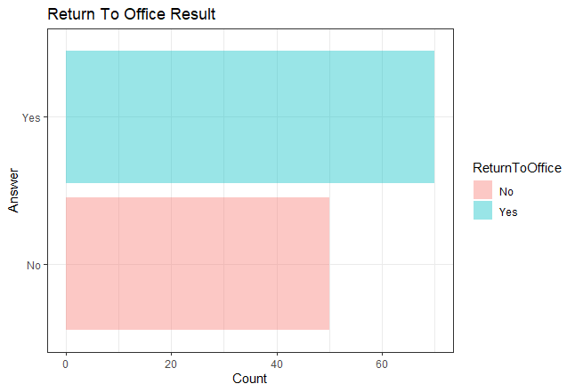
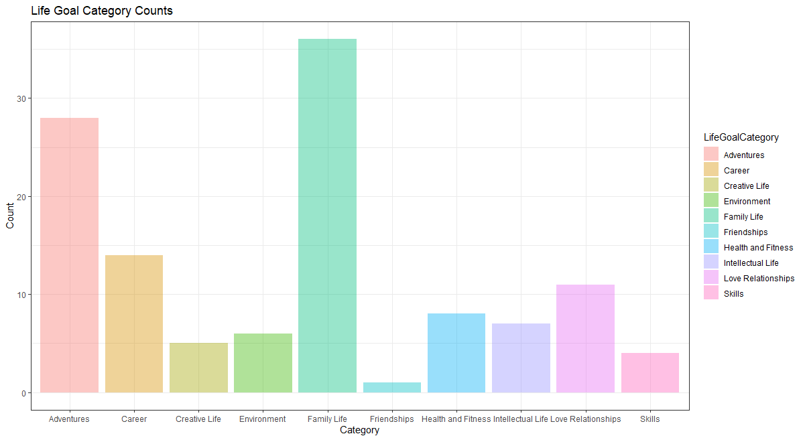
DATA EXPLORATION

Slide 11
PREDICTION AND OUTCOME – MODEL 1

Slide 12
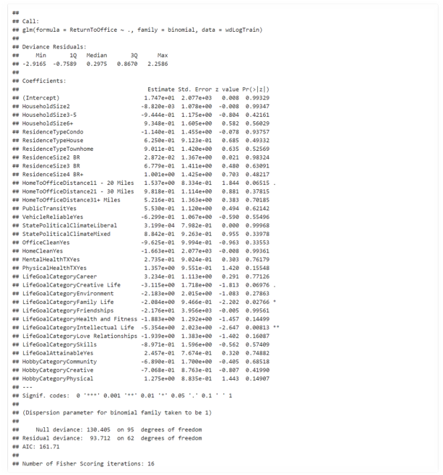
LOGISTIC REGRESSION MODEL 1
ALL FEATURES
4 FEATURES HIGHLIGHTED

Slide 13
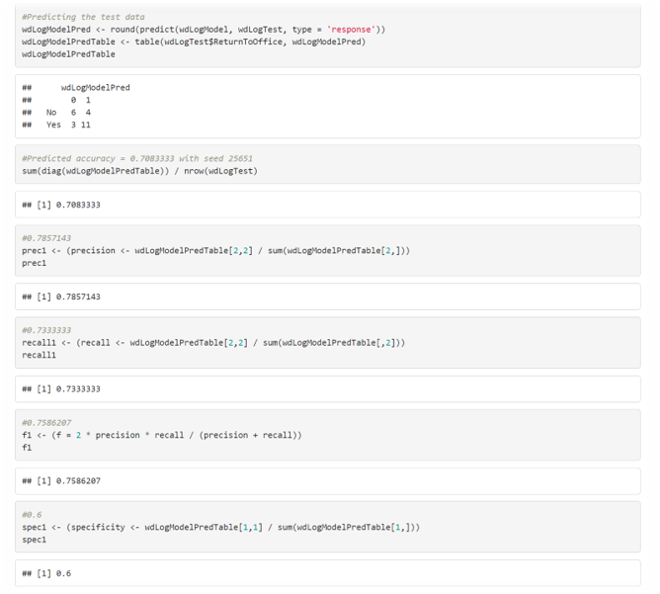
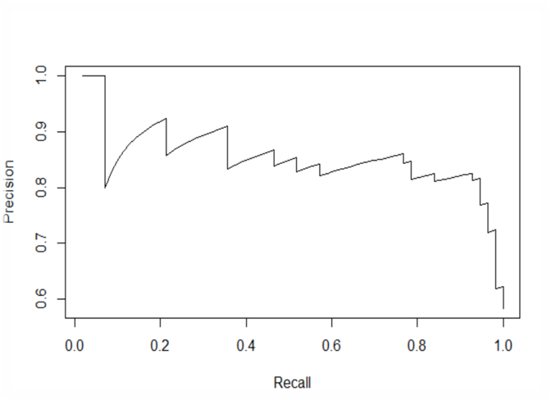
MODEL EVALUATION
0.708 ACCURACY WITH CHOSEN SEED
TRUE POSITVE VS. POSITIVE PREDICTIVE VALUE

Slide 14
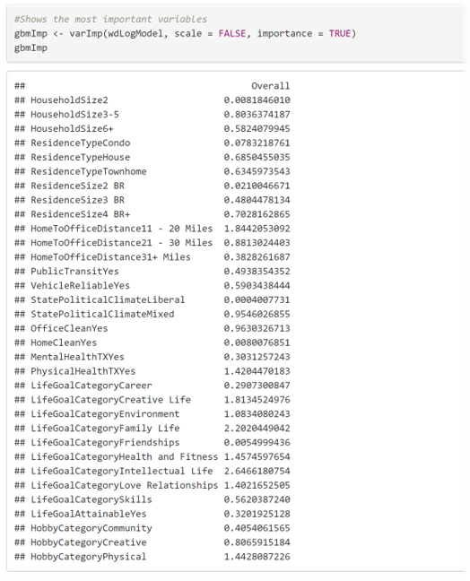
FEATURE IMPORTANCE
LIFEGOAL CATEGORY
PHYSICAL HEALTH TX
HOME TO OFFICE DISTANCE

Slide 15
PREDICTION AND OUTCOME – MODEL 2

Slide 16
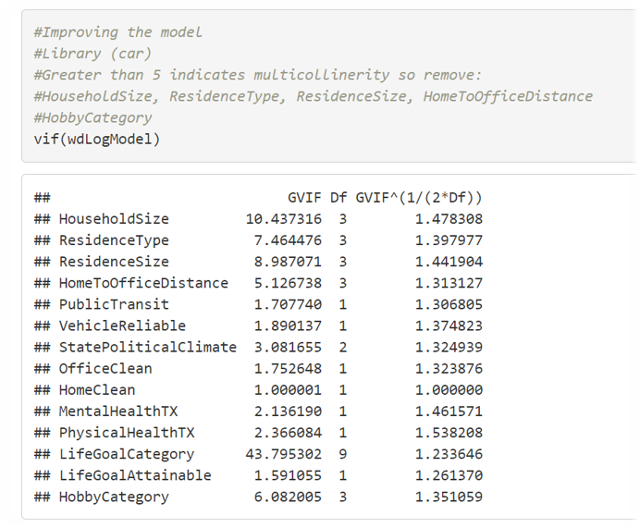
VARIABLE INFLATION
A GVIF OVER 5 SHOULD BE REMOVED

Slide 17
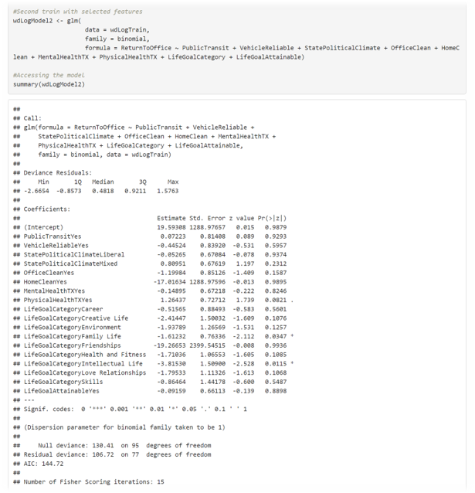
LOGISTIC REGRESSION MODEL 2
VIF IDENTIFIED FEATURES
NO CHANGES

Slide 18
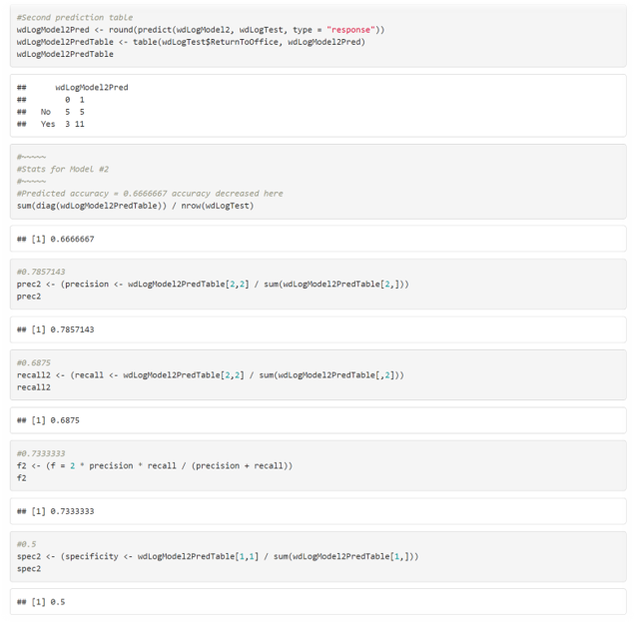
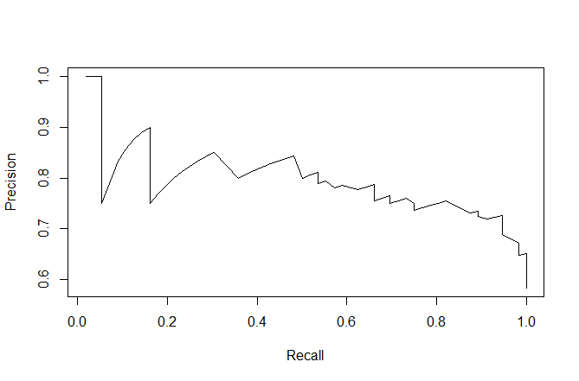
MODEL EVALUATION
0.6666667 % ACCURACY WITH GVIF FEATURES
TRUE POSITVE VS. POSITIVE PREDICTIVE VALUE

Slide 19
PREDICTION AND OUTCOME – MODEL 3

Slide 20
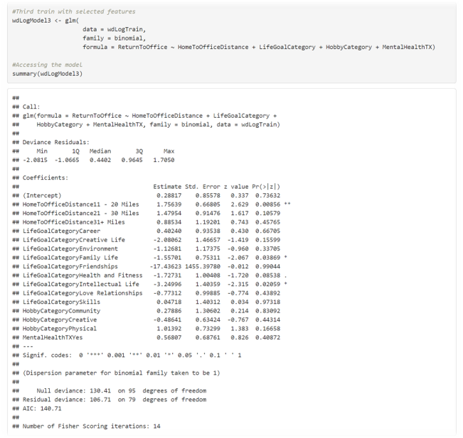
LOGISTIC REGRESSION MODEL 3
4 MOST IMPORTANT FEATURES
NEW LAYER OF LIFEGOAL IMPORTANCE FOUND

Slide 21
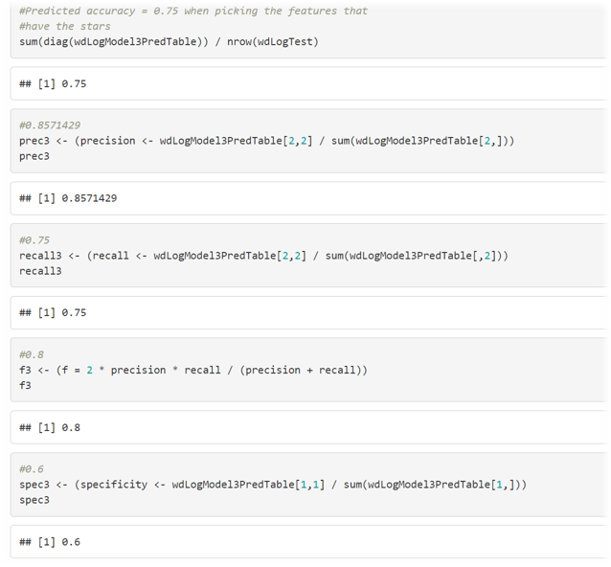
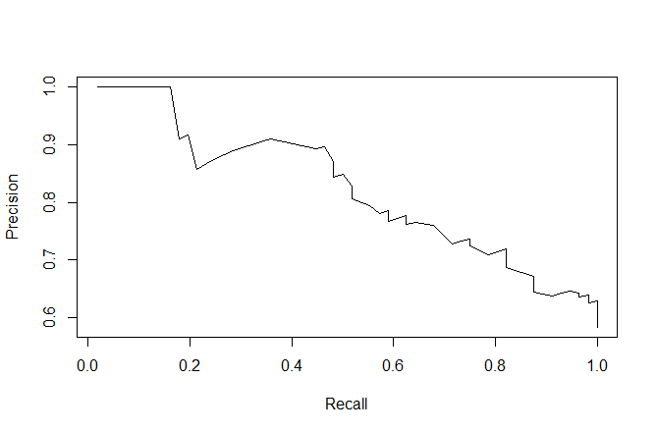
MODEL EVALUATION
0.75% ACCURACY WITH TOP 4 FEATURES
TRUE POSITVE VS. POSITIVE PREDICTIVE VALUE

Slide 22
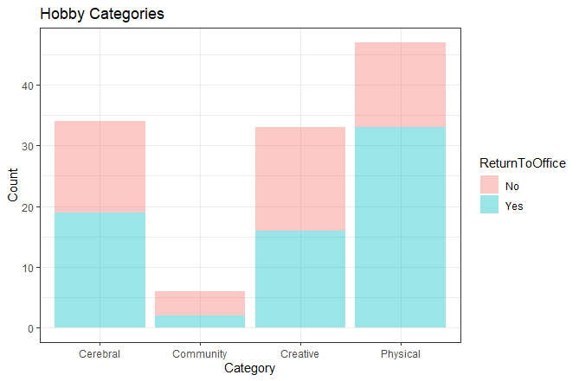
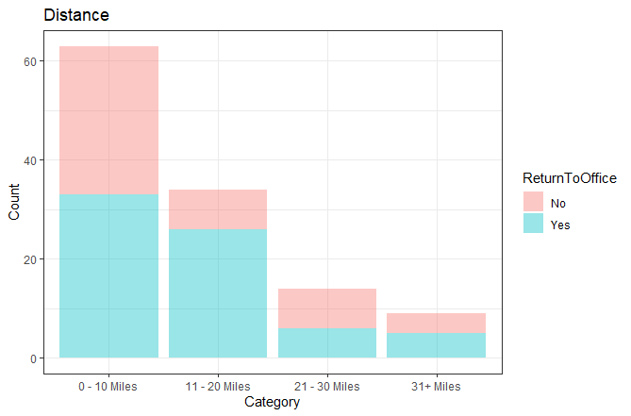
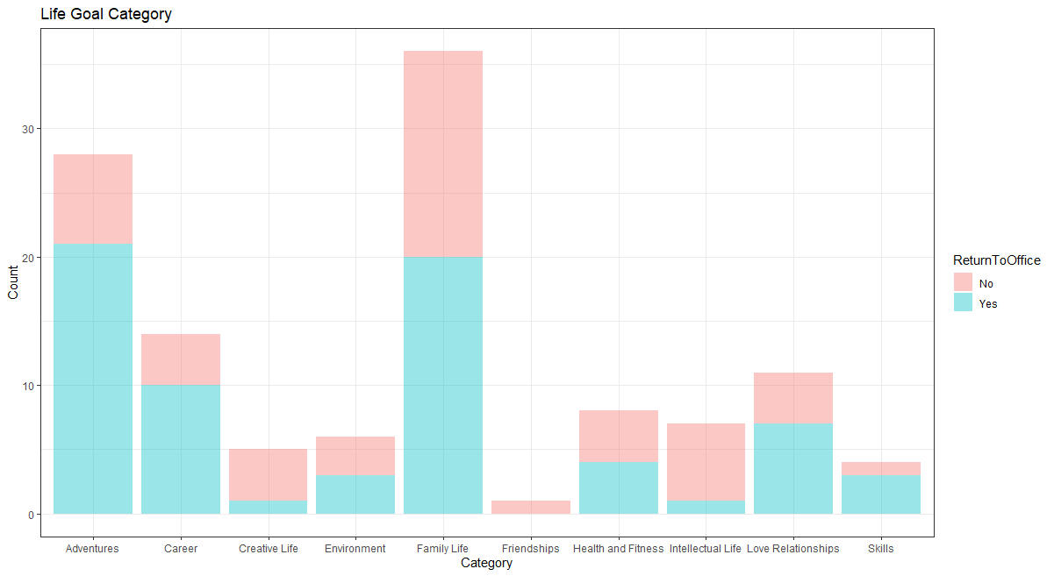
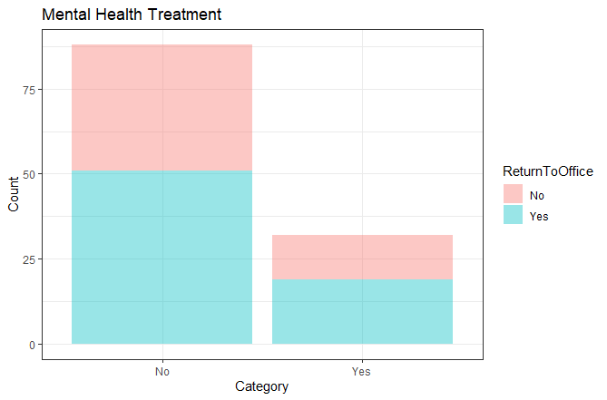

Slide 23
CONCLUSIONS

Slide 24
FINDINGS
The difference in seeds between the models at some points made a significant difference and allowed further insight into the more inner workings of how this data connected together
Many respondents do want to return to the office
With the current data, it was not possible to accurately predict a return-to-office status
Only one other individual answered that they did not feel like their home was safe, clean and comfortable
The size of someone’s family and house did not seem to be significant when approaching the topic of returning to the office, despite likely being locked in it for well over a year
If an individual places value on their intellectual life, this data has begun to suggest that it could play a factor in whether an individual wants to return to an office setting

Slide 25

CHALLENGES
MODEL CHOICE AND VISUALIZATION
KNOWING WHEN POOR RESULTS ARE ACCEPTABLE
KNOWING WHEN ENOUGH IS ENOUGH
NOT ENOUGH DATA
ONLY CATEGORY FEATURES – NO NUMERIC DATA

Slide 26
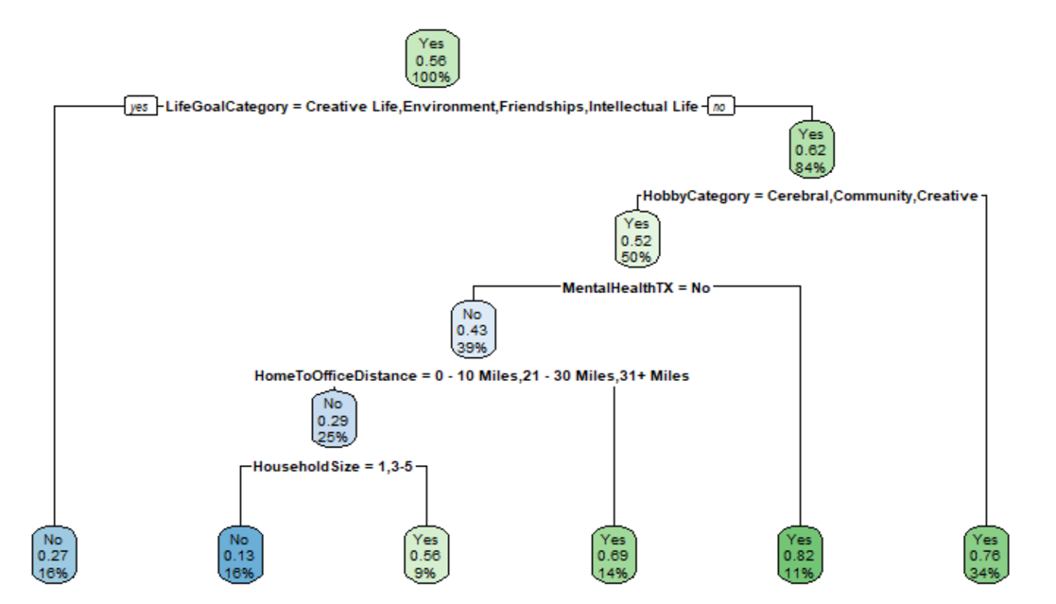
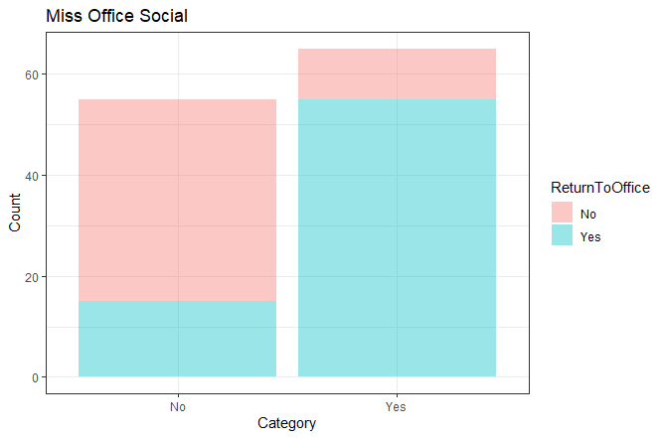
NEXT STEPS
SECONDARY SURVEY WITH CURRENT PARTICIPANTS AFTER 6 MONTHS
ATTEMPT DECISION TREE OR CLUSTERING
EXPLORE MORE FOCUSED QUESTIONS ON INTELLECTUAL LIFE
OBTAIN ADDITIONAL DATA FROM PROLIFIC USERS

Slide 27
THANK YOU!

